Slide 1



Quality Analytics
View in Power BI
Last data refresh:
6/3/2019 12:36:13 PM Eastern Standard Time
Downloaded at:
6/3/2019 12:49:47 PM Eastern Standard Time

Slide 2
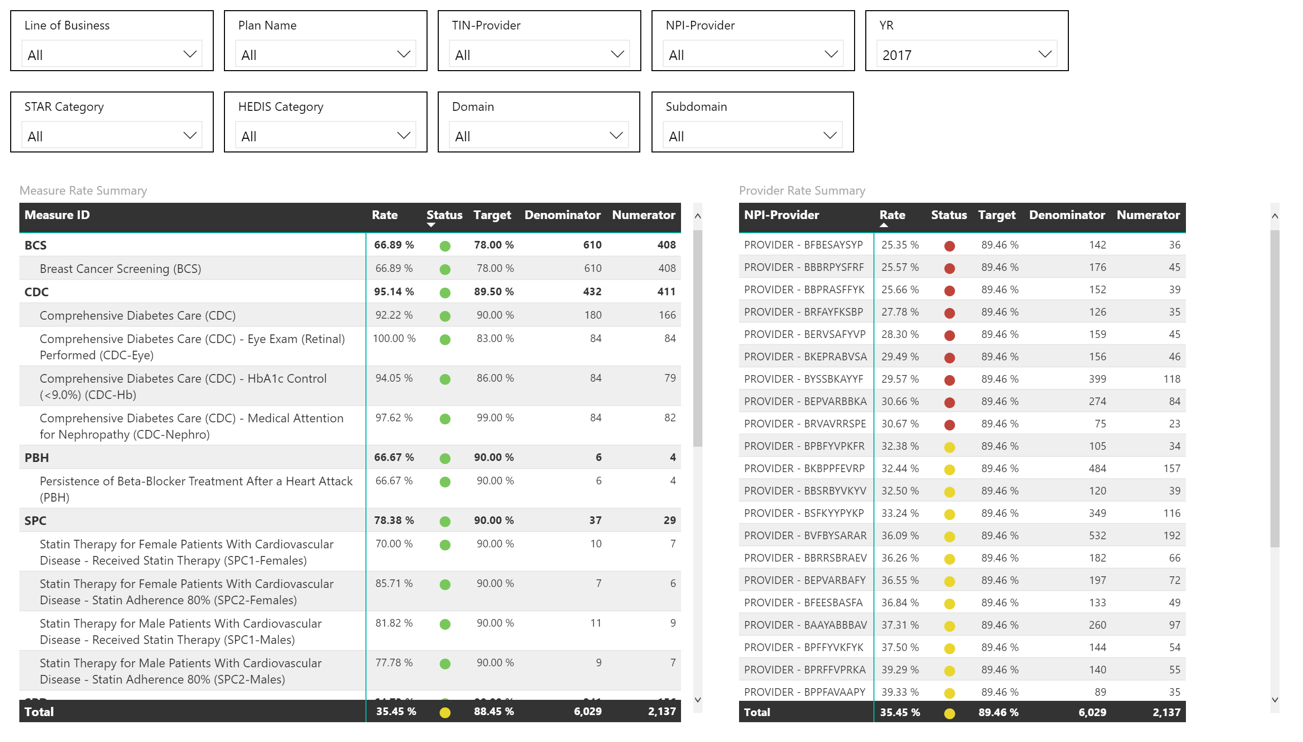

Slide 3
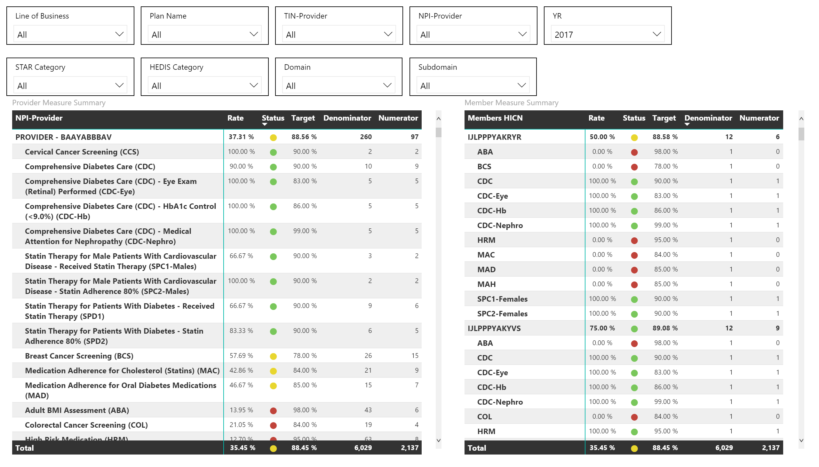

Slide 4
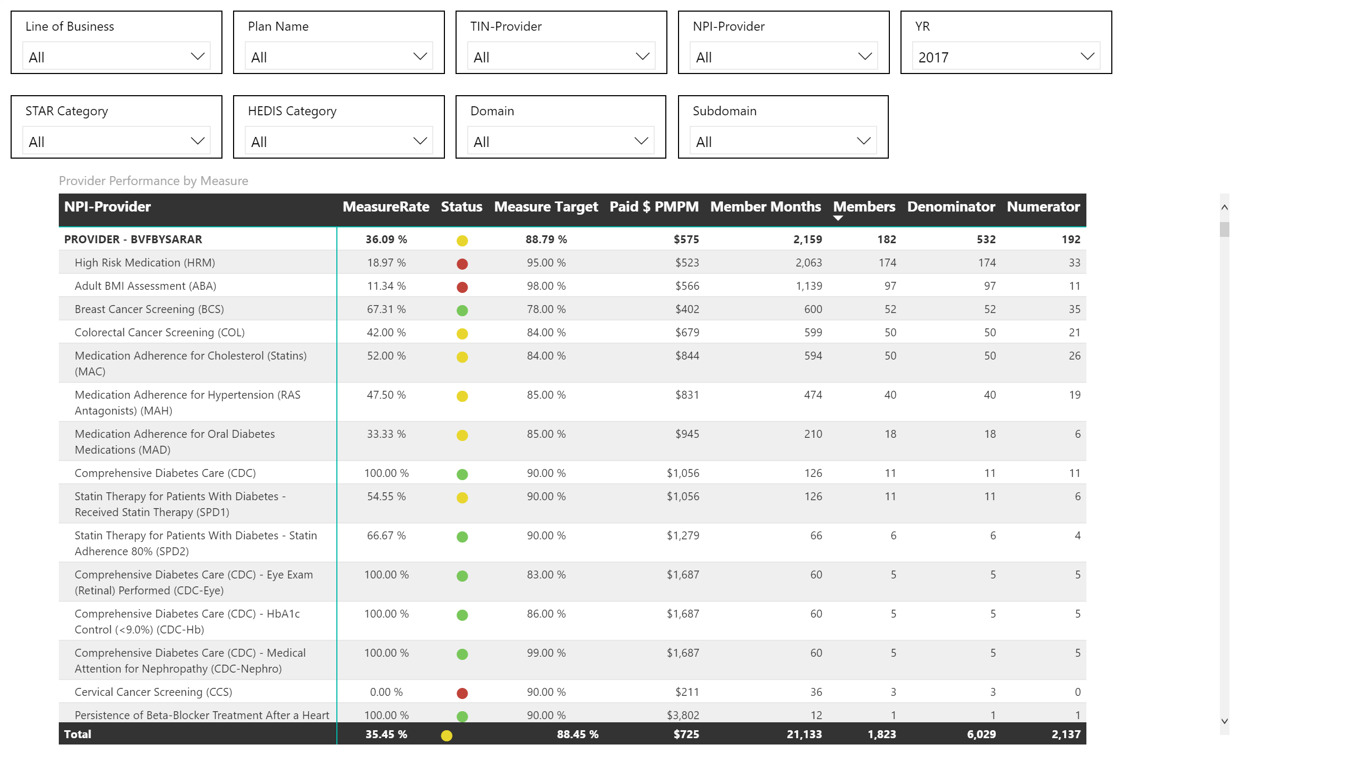

Slide 5
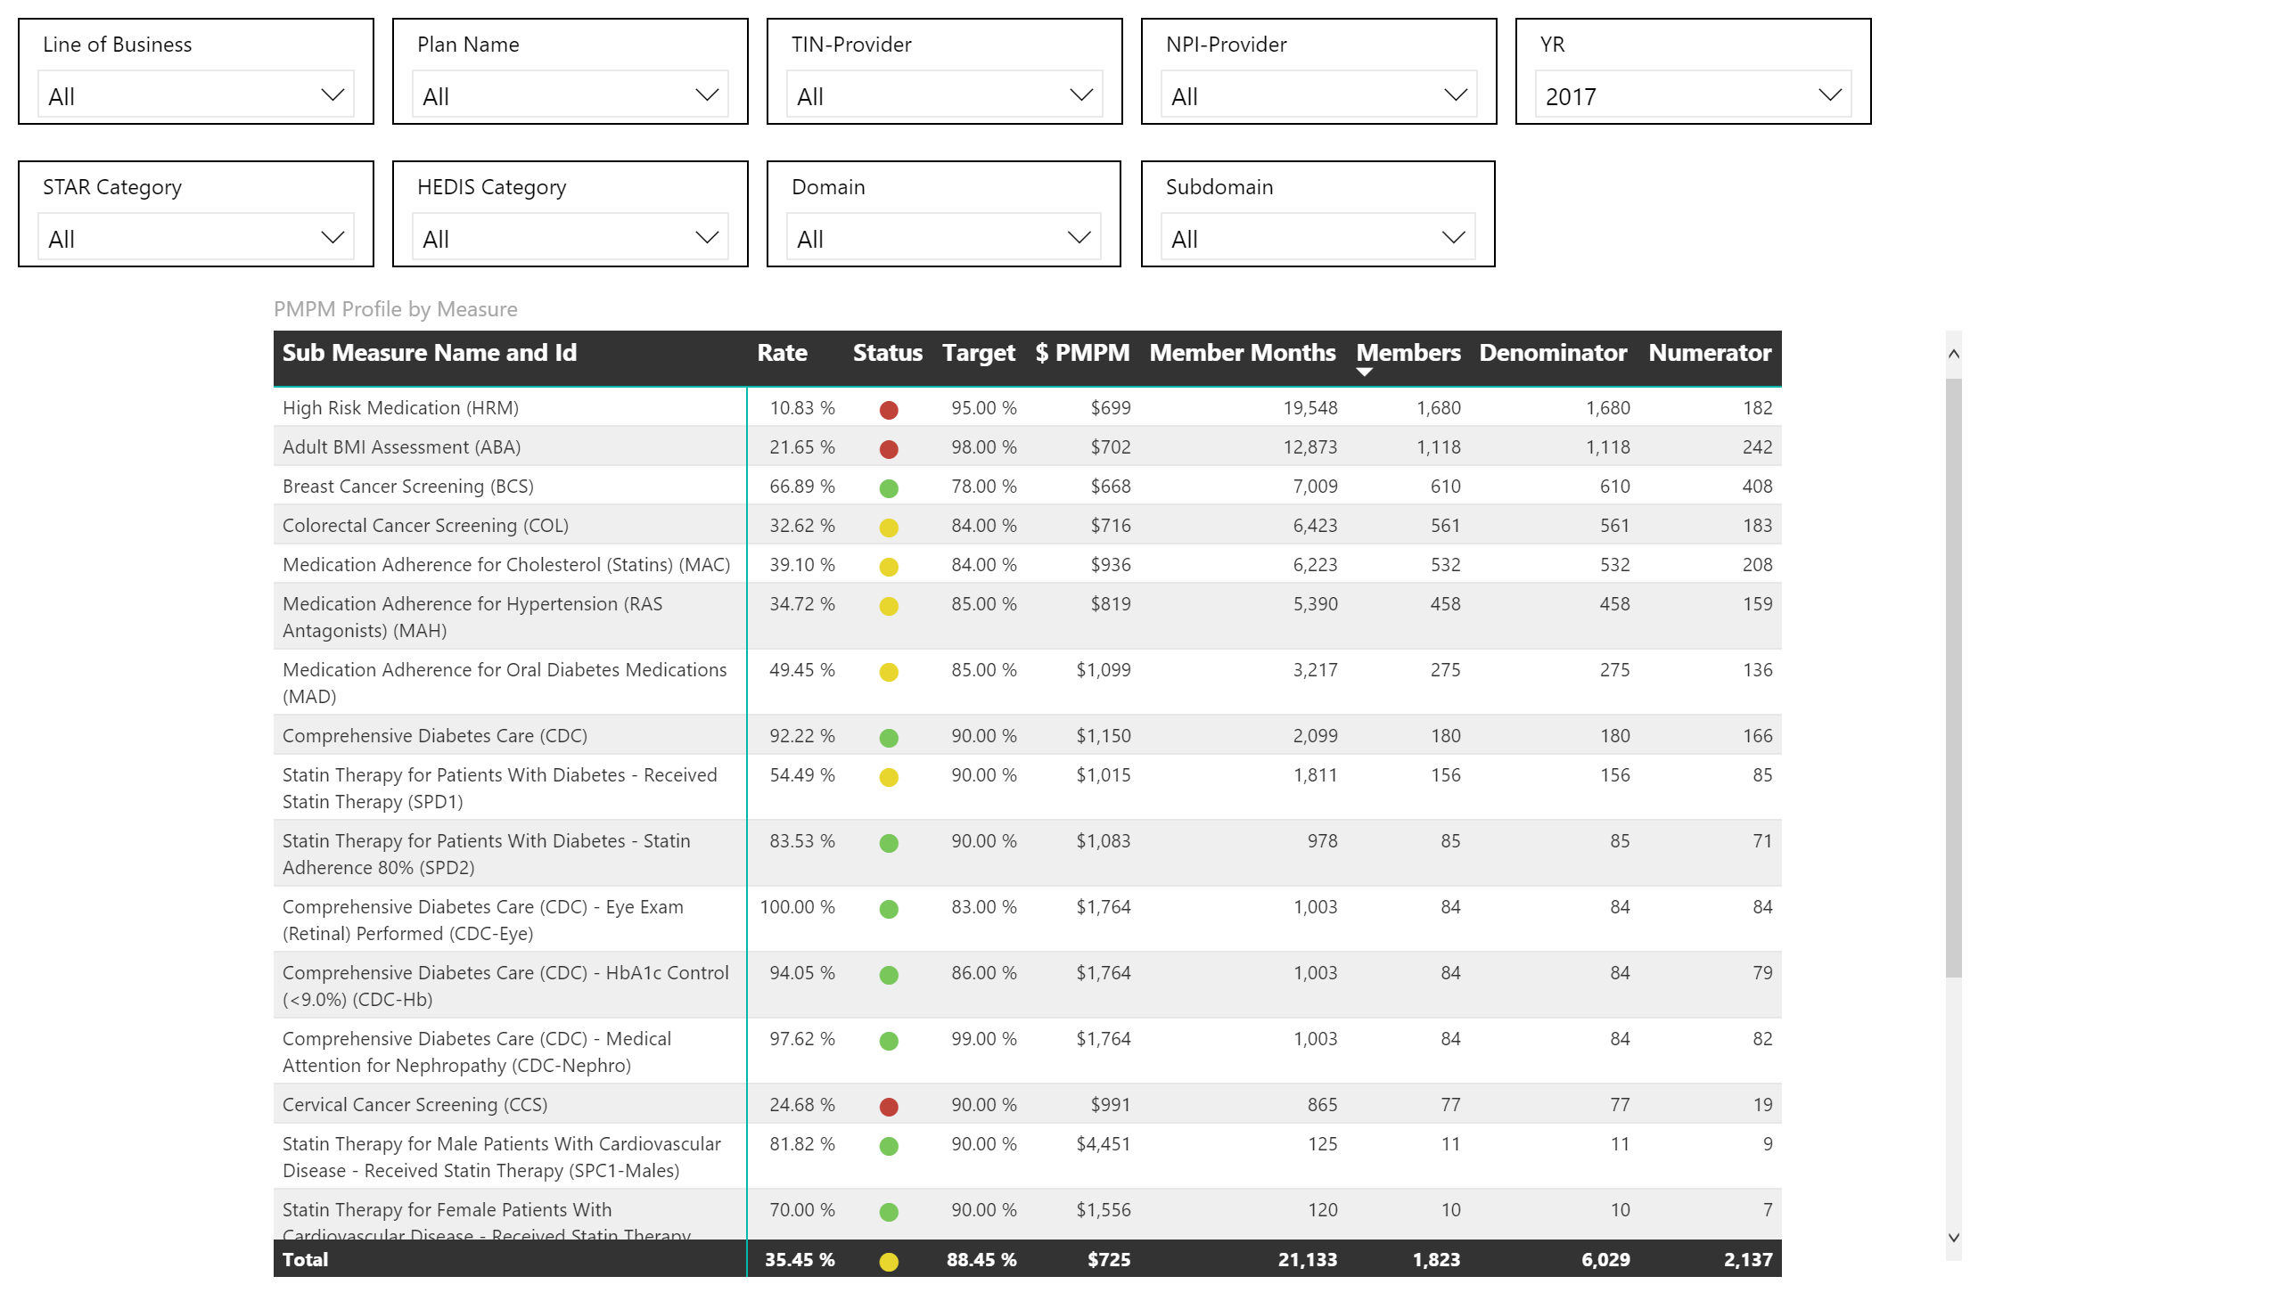

Slide 6
